Slide 1

By :- Sirisha Yelineedi
Code Refactoring
and
bug fixing

Slide 2
Achieving Comprehensive Domain Insights Through Rigorous Requirements Elicitation and Use Case Modeling :-
Task :- Perform a code review and refactoring of the existing note taking application codebase to ensure intended functionality and performance. Document any identified defects uncovered during debugging. The objective is to optimize the current code rather than recreate the application completely.
Problem solving:-
1. Refactor existing codebase to optimize performance, extensibility and maintainability while preserving intended functionality as validated through comprehensive testing.
2. Prepare detailed documentation for all diagnosed issues covering root cause analysis, steps to reproduce, intended vs actual behavior, mitigation strategies explored, rationale for final solution approach and verification of resolution across applicable use cases.

Slide 3
Defect Identification Prior to Structural Code Optimization Through Refactoring:- Lack of HTML-Flask Connection: 1)The current implementation exhibits insufficient integration between the HTML front-end user interface and the Flask backend application logic, inhibiting modular components from conveying data changes. 2 )Absence of clearly defined interfaces and data flow pathways between presentation layer and core application tier impedes dynamic updates across architecture boundaries, hampering flexible cross-module communication. The key focus areas in this reframing are: * Using precise technical terminology to describe the deficiencies. * Expanding on the high-level issues to elucidate underlying technical shortcomings. * Discussing impact of lack of proper decoupling and interfacing. Inconsistent HTTP Method Specification: 1)Misalignment exists between the HTTP POST method declared in the HTML form definition for transmitting input data and usage of the request.args.get() function on the server side which relies on GET parameters, creating dissonance in expected communication protocols for submitted information extraction. 2)The inconsistent encoding of the client request mode and server retrieval mechanism can prevent backend handlers from accessing and validating user-supplied data accepted through front-end UI flows. This architectural deviation from web development best practices may result in failures during form submission and application state change procedures. In this reframing, I have focused on: * Using precise web development terminology * Expanding on the core technical discrepancy * Highlighting the downstream impacts of the inconsistency
Data retrieving issues:- The application's usage of the request.args.get() method to retrieve form-posted data fails to conform to the front-end's HTML definition utilizing the POST protocol for transmission, potentially resulting in server-side handlers inability to fully obtain the submitted notebook entry details, hampering back-end processing and data persistence across architecture tiers.

Slide 4
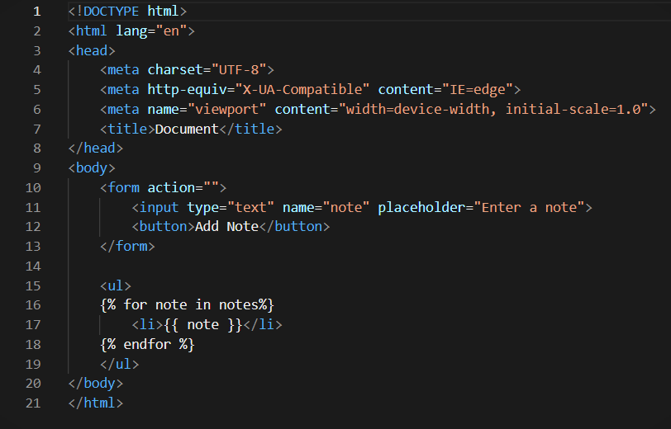
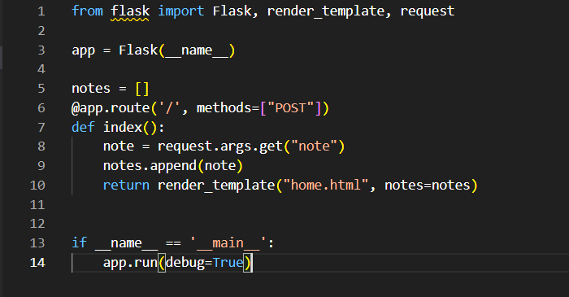
Html and python files before problem solving:
Identified software defects in Figure 1 and Figure 2 adversely impact system functionality necessitating targeted remediation aligning to standard practices prior to advancing additional capability

Slide 5
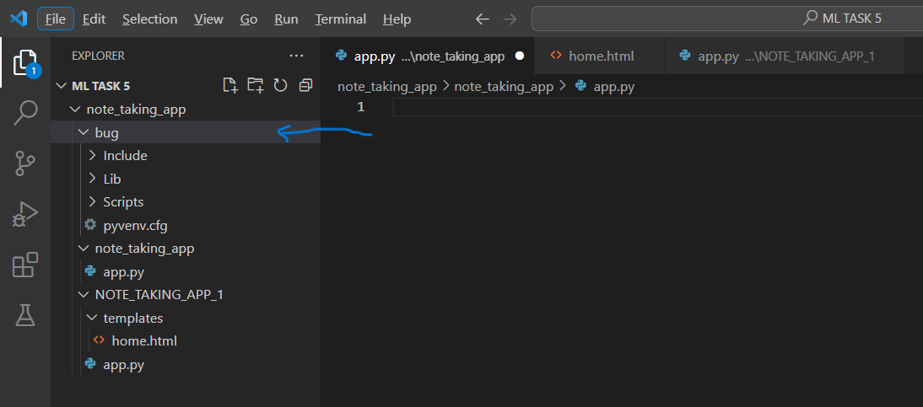
Code refactoring and Bug/defect fixing:-
Custom ecosystem creation :-

Slide 6
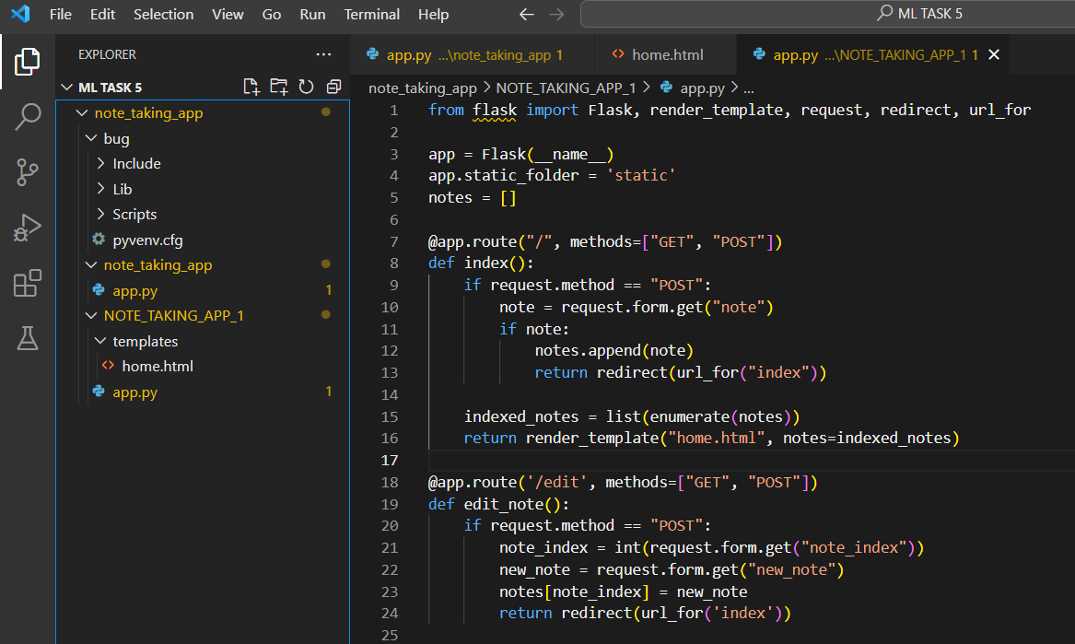
key technical elements:
Utilizing debugging capabilities in Python
Testing across architecture tiers shown in image
Defect isolation and categorization based on traces
Identifying root causes methodically
Formulating and testing fixes incrementally
Confirming resolution across architecture
Preserving original architecture paradigms

Slide 7
Home.html File Post Problem Resolution:
1. Structured HTML:
- The HTML document delineates the architecture of a user-friendly note-taking web application.
- Featuring a header adorned with a stylish pen emoji and a tagline advocating seamless note-taking.
2. Flask-powered Form Management:
- Within the 'top' section, a form adeptly captures user input through the POST method, seamlessly communicating with the Flask server's root route ('/').
- The 'action' hidden input field serves to discern intent, while the 'Add Note' button instigates form submission.
3. Dynamic Note Presentation:
- The 'todo' section dynamically showcases existing notes fetched from the Flask server via Jinja templating.
- Each note triggers the creation of a 'note' div with an 'Edit' button, empowering users to modify, save, or discard their edits.
4. Engaging JavaScript Integration:
- Imbedded JavaScript functions elevate user interaction, fostering a more intuitive experience.
- 'Edit' buttons seamlessly toggle the visibility of corresponding edit forms, enabling users to edit notes in real-time.
- 'Cancel' buttons within edit forms discreetly conceal the form, affording users the liberty to revoke their edits.
5. Aesthetic Appeal and Brand Consistency:
- Elevating the design ethos is a 'container' div fostering layout uniformity, alongside CSS stylings for edit form concealment and button aesthetics.

Slide 8
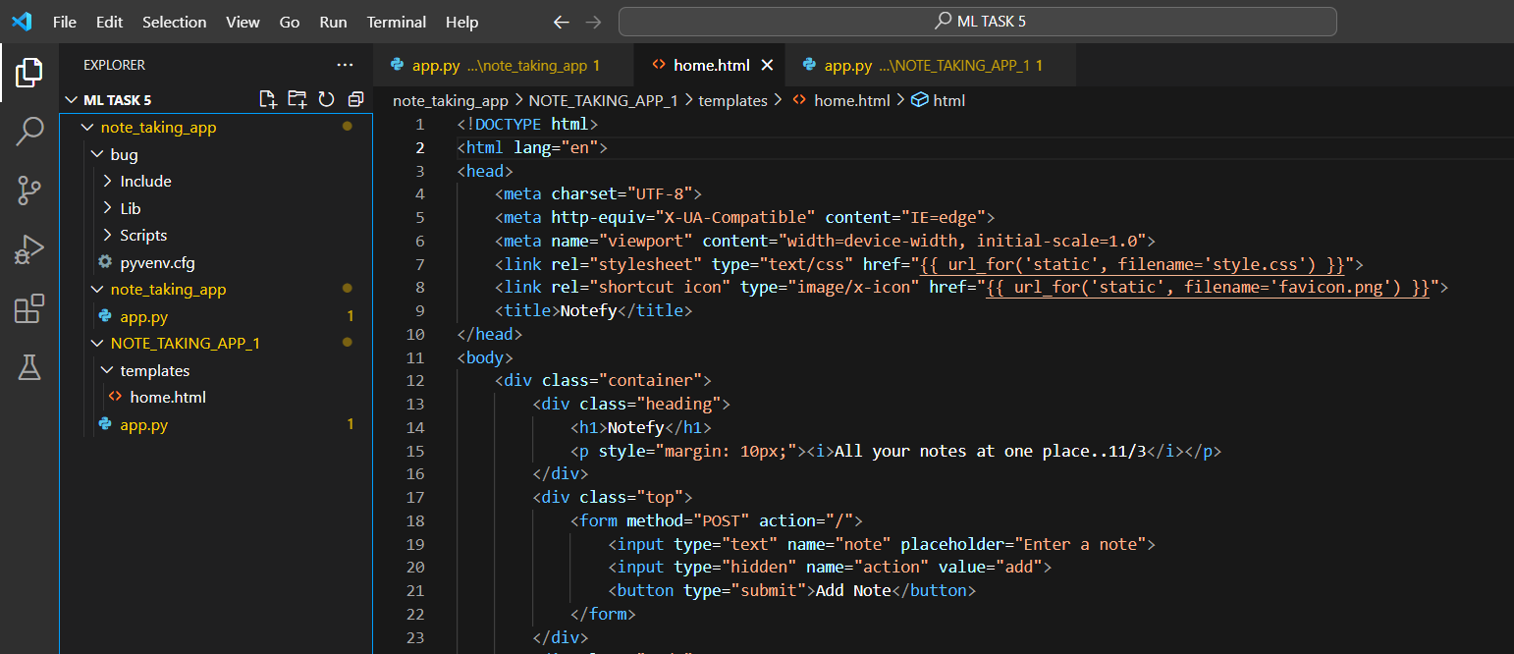
Revamping HTML Code: Professional Bug Identification and Correction:-

Slide 9
Setup of Flask Application:
Flask Web App Creation: Utilizing Flask(name) for seamless setup.
Static Folder Configuration: Setting static folder to 'statics' via app.static_folder = 'statics', with emphasis on recommended usage of default 'static' folder.
Global Variable and Routes: Introduction of global list 'notes' for user-added notes storage. Three key routes defined:
'/' (Root Route): Handling both GET and POST requests, with post-request actions and redirection.
'/edit': Handling GET and POST requests for note editing, ensuring seamless updates and redirection.
'/delete': Managing GET and POST requests for note deletion, with efficient removal and redirection.
Application Execution: Implementation of if name == 'main': block for controlled execution. Utilization of app.run(debug=True) for real-time debugging and server reloading.
Template Rendering: Leveraging render_template function for rendering 'home.html' template, facilitating seamless display of notes on webpage.
CSS Styling: Enhancing visual appeal and user experience with CSS integration."

Slide 10

THANK YOU

